Slide 1
Applied Machine Learning Final Project: Home Credit Default Risk
Indiana University
December 2022
Group 11
Anuj Mahajan
Shubham Jambhale
Shashwati Diware
Siddhant Patil

Slide 2

Team Members:

Slide 3
Contents
Four P’s
Project Description
Summary EDA
Overview of modeling Pipelines
Results and discussion (Accuracy, AUC, Kaggle)
Conclusion and Next steps

Slide 4
Four P’s
Past:
We began the HCDR Project, which uses a variety of financial and nonfinancial variables to determine
whether borrowers will fail or not.
In the initial stage, we performed fundamental EDA and data collection.
We decide on the baseline models that will be applied in Phase 2 ( Decision Tree, Random Forest, and
Logistic Regression)
Present:
First, we chose more pertinent features and imputed missing values from them.
We used these datasets to develop baseline models (Logistic Regression, Decision Tree, and Random Forest).
AUC and the Confusion Matrix were used to assess the accuracy.
We calculated loss using log loss.

Slide 5
Four P’s
Planned:
We will tune the hyperparameters of the models, and we will try to find the best parameters using Grid Search.
In the steps above, we used the best parameters for each model, to evaluate the models.
We shall attempt to carry out extensive feature engineering to enhance the results.
Problems:
With the given feature selection, we could not improve the test accuracy or AUC of the baseline model beyond a certain level.
Even if the decision tree model’s AUC is on the upper side, log loss is still significant.
We may need some prior knowledge about the data, for example, credit data

Slide 6
Project Description:
The object of the Home Credit Default Risk (HCDR) project is to predict the repayment abilities of the financially under-served population.
The well-established prediction is necessary for both Home Credit and borrowers.
Lend money to whom can pay back and give them a chance to build credit.
We use a variety of data, such as past credit information, credit type, past credit days left, payments, past
application information, etc.
We use categorical and numerical data to improve the accuracy of our predictions.
We provide appropriate datasets for machine learning models using EDA.
We trained and assessed a number of potential models before selecting the best one.
Our potential models include Random Forest, Decision Making Trees, and Logistic Regression.
Accuracy, AUC, Confusion Matrix, and Log Loss are just a few of the measures we employ to evaluate
candidate models specifically.
We observed that the Random Forest baseline pipeline has the highest test accuracy which is then followed by the Logistic Regression and Decision-making Tree.

Slide 7
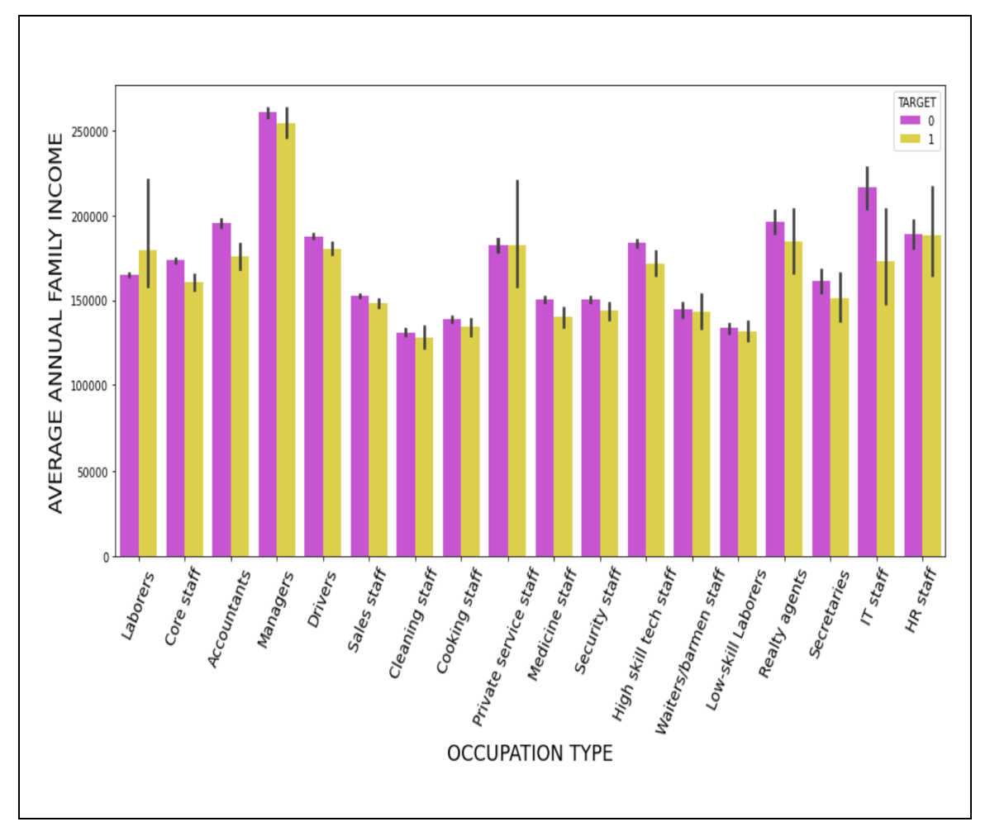
Exploratory Data Analysis (EDA):
We perform EDA and examine the following attributes of the data
Test Description, Dataset size, Summary Statistics, Correlation analysis, Checking missing values, etc.
Some Interesting EDA findings:
Occupation Type Vs Annual Family Income

Slide 8
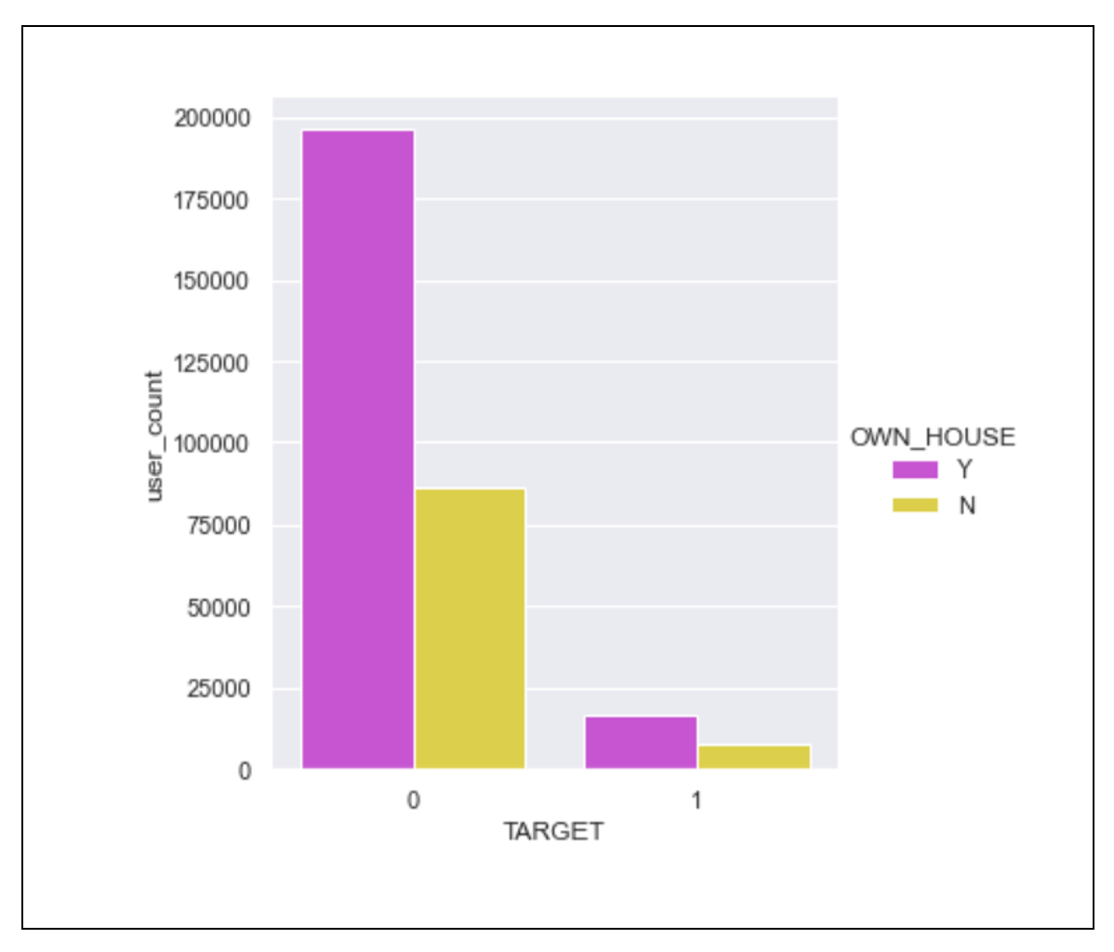
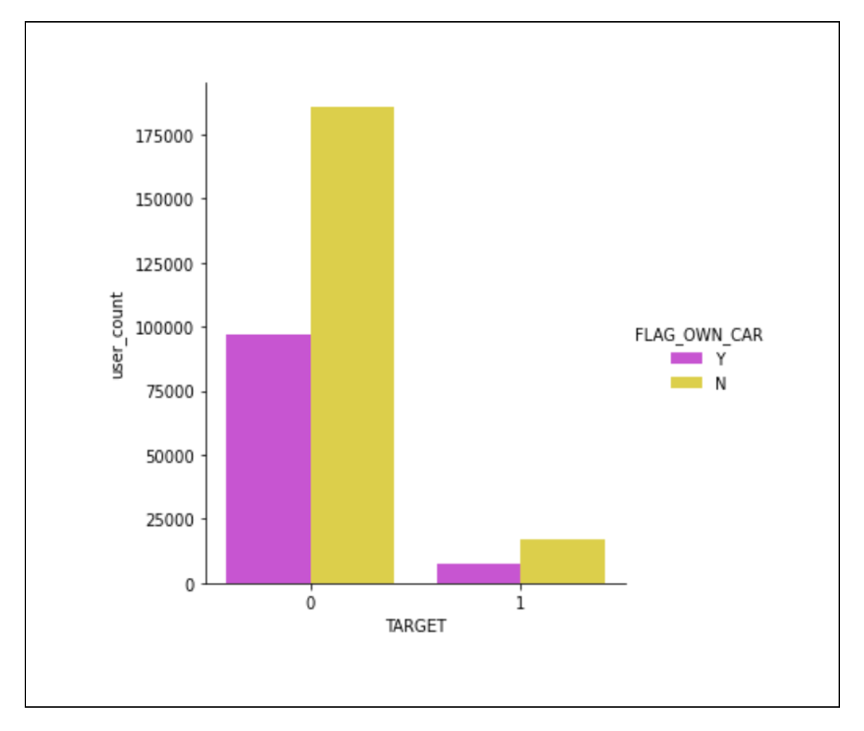
Exploratory Data Analysis (EDA):
Defaulters and Non-defaulter in terms of Home Ownership
Defaulters and Non-defaulter in terms of Car Ownership

Slide 9
Feature Engineering:
Feature selection and imputation
We discarded features with missing values of more than 50% and dropped irrelevant features.
We filled in the missing values of selected features.
Adding more relevant data
We decided to add relevant features based on our prior knowledge.
e.g. Salary-to-Credit Ratio, Total External Source

Slide 10
Modelling Pipeline:
The goal is to predict whether the borrower is a defaulter or not. Phase 2 involves creating baseline models (Logistic Regression, Decision Tree, Random Forest)
Separate the dataset into training and testing data
Prepare the input dataset by converting missing values and scaling the data.
Perform a baseline model.
Analyze the baseline model using measures for accuracy, AUC, and log loss.
Perform steps 1–4 for all the baseline models.

Slide 11
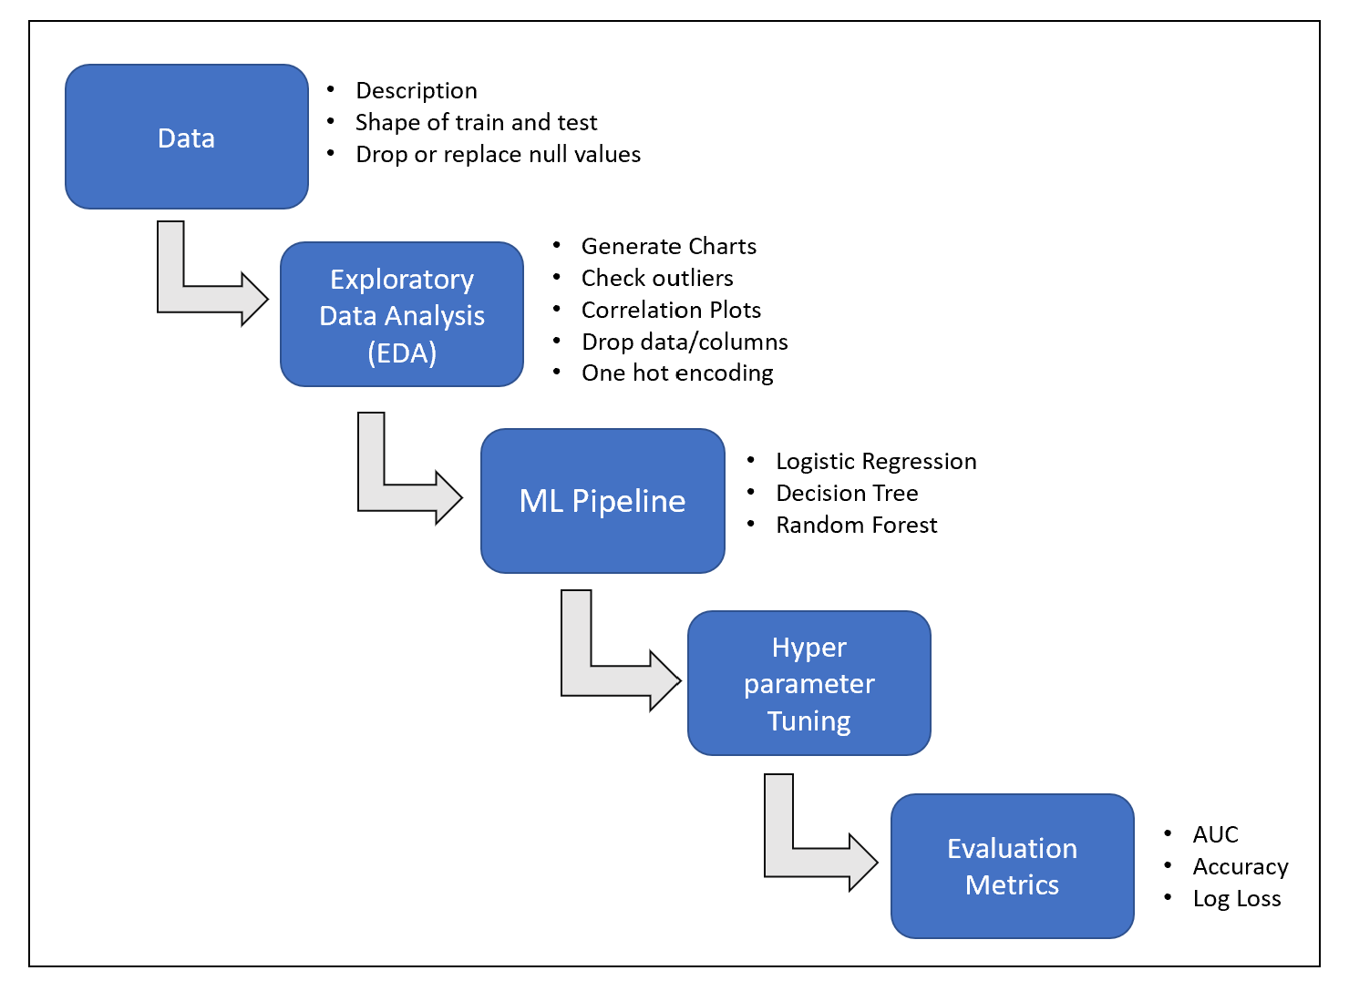
Modelling Pipeline Flow:

Slide 12
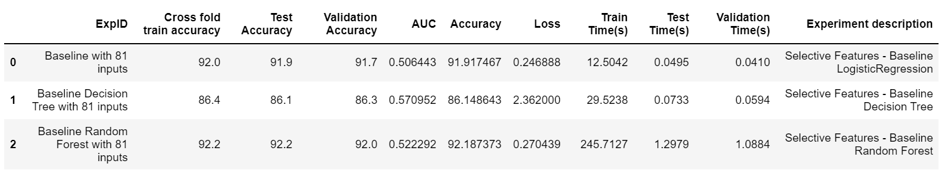
Result and Discussion:
Logistic Regression performs well on the given dataset.
AUC and Accuracy (91.9) for Logistic Regression are on the higher side.
Random Forest outperforms baseline Logistic Regression and Decision Tree.
It provides the highest accuracy of 92.2.
Decision Tree seems to have low test accuracy of 86.1.
It might be due to the short depth of the decision tree.
In turn AUC has increased significantly.

Slide 13
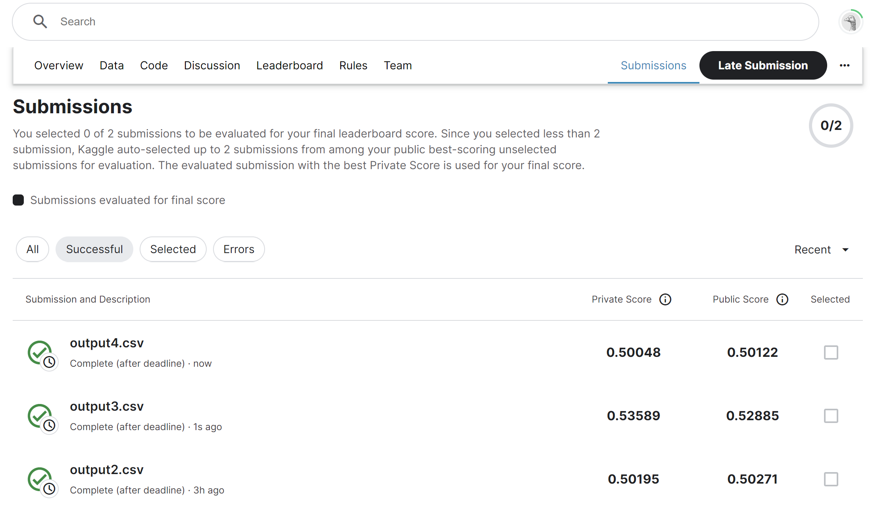
Result and Discussion:

Slide 14
Conclusion and Next steps:
In Phase 2 we conclude that the decision tree model cannot outperform the other baseline model with the lowest test accuracy.
Even though the test accuracy is low, for Decision Tree AUC is highest.
Out of all the baseline models, the random forest model performs the best followed by logistic regression.
In the future, we intend to put all models into practice in phase 3 by performing below steps:
Additional Feature Engineering
Hyper-parameter Tuning

